Slide 1
Scientific Conferences
How to make the most of scientific meetings
Poster Sessions
Oral Presentations

Slide 2
Making the most of Scientific Conferences
DISCUSS: What are some suggestions to do BEFORE the conference?

Slide 3
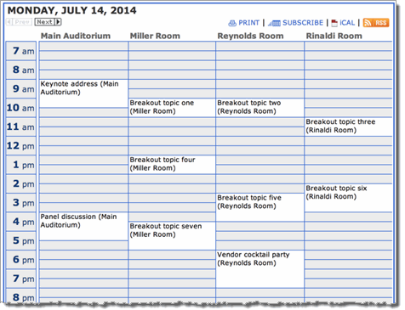
Making the most of Scientific Conferences
Review program ahead of time
Identify priority sessions, workshops and posters
Make a calendar
Download and use the Event App
Go to registration table as soon as possible

Slide 4
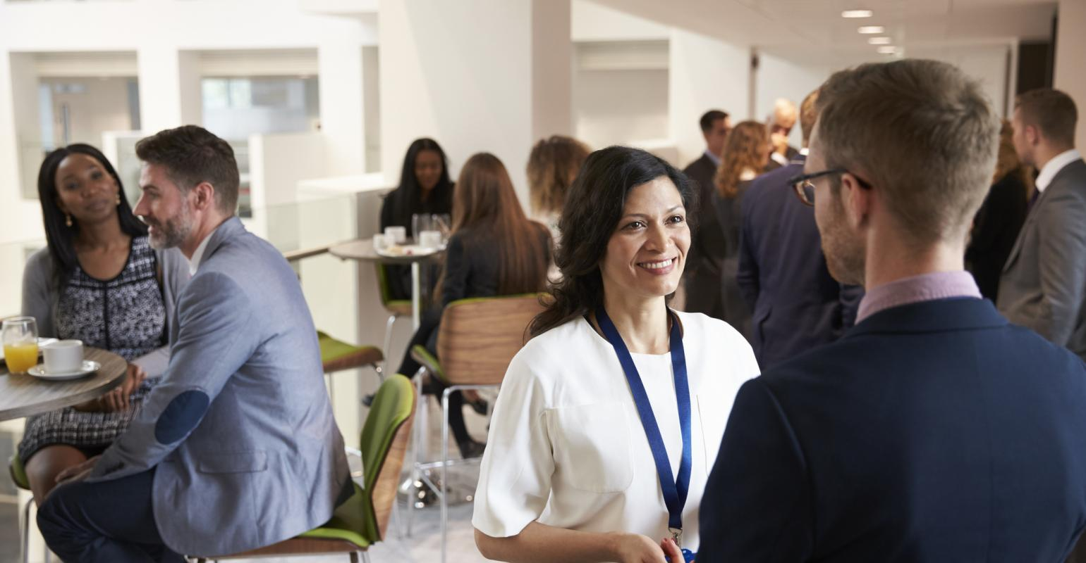
Making the most of Scientific Conferences
Practice your elevator pitch!!!
Contact collaborators and potential collaborators in advance
Plan meetings during breaks
Coffee breaks, lunches, dinner & happy hours are where some of the most important progress is made during conferences
Important to learn about future prospects (e.g. fieldwork, jobs, movement of other folks etc.)

Slide 5
Making the most of Scientific Conferences
DISCUSS: What are some suggestions to do DURING the conference?

Slide 6

Making the most of Scientific Conferences
Take Notes
Have a notebook: take notes during talks, write down questions (in case you forget when you stand up at the microphone)
When you ask a question, state your name, where you work/study, and then ask your question (gives ppl an easy way to follow up with you if they’re interested in the question you asked)
Practice taking notes and asking questions at weekly seminars

Slide 7
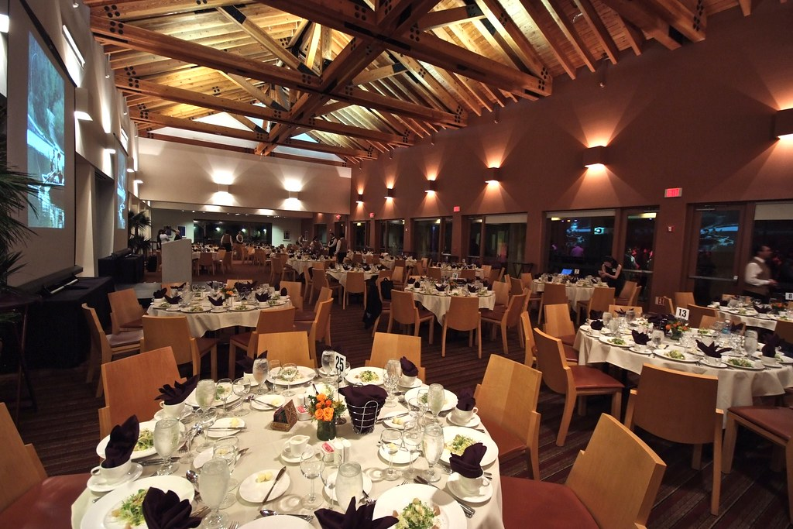
Making the most of Scientific Conferences
Extracurricular activities
Ice-breaker, field trips, fun runs, dances, dinners are great opportunities to make meaningful connections with colleagues, conduct informational interviews, and broaden your network

Slide 8
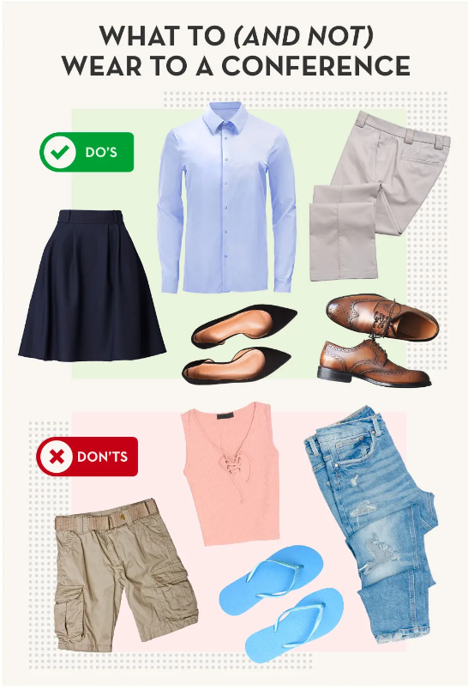
Making the most of Scientific Conferences
Be Professional
Dress professionally
First impressions are important
How you dress can have an impact on your self-esteem and confidence
Hotels are often VERY air-conditioned; dress in layers
*At academic conferences, most people care about what you SAY, not what you look like. So don’t worry about attire too much
From: Crestline’s “What to Wear to a Conference: The Ultimate Guide”

Slide 9
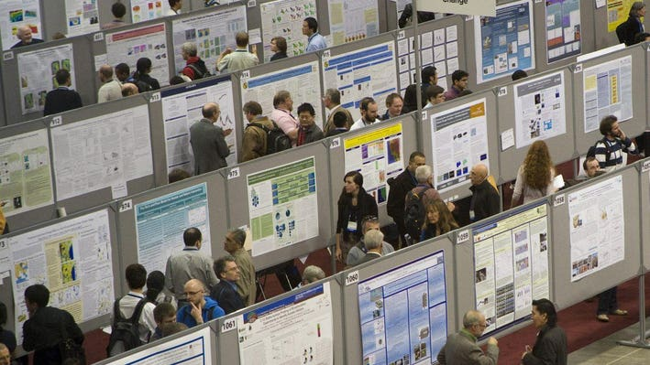
Poster Sessions
Be proactive about attracting people to your poster (e.g. LinkedIn or social media announcement)
When people approach your poster, ask if you can walk them through it
Include a QR code that links to your website (w/contact details) or a digital version of the poster

Slide 10
Poster Sessions
Goal: Teach people something you learned in 5 seconds as they walk by
Big and Bold format without too much text
Clarity is essential. Should be able to read text and important results from at least 10’ away

Slide 11
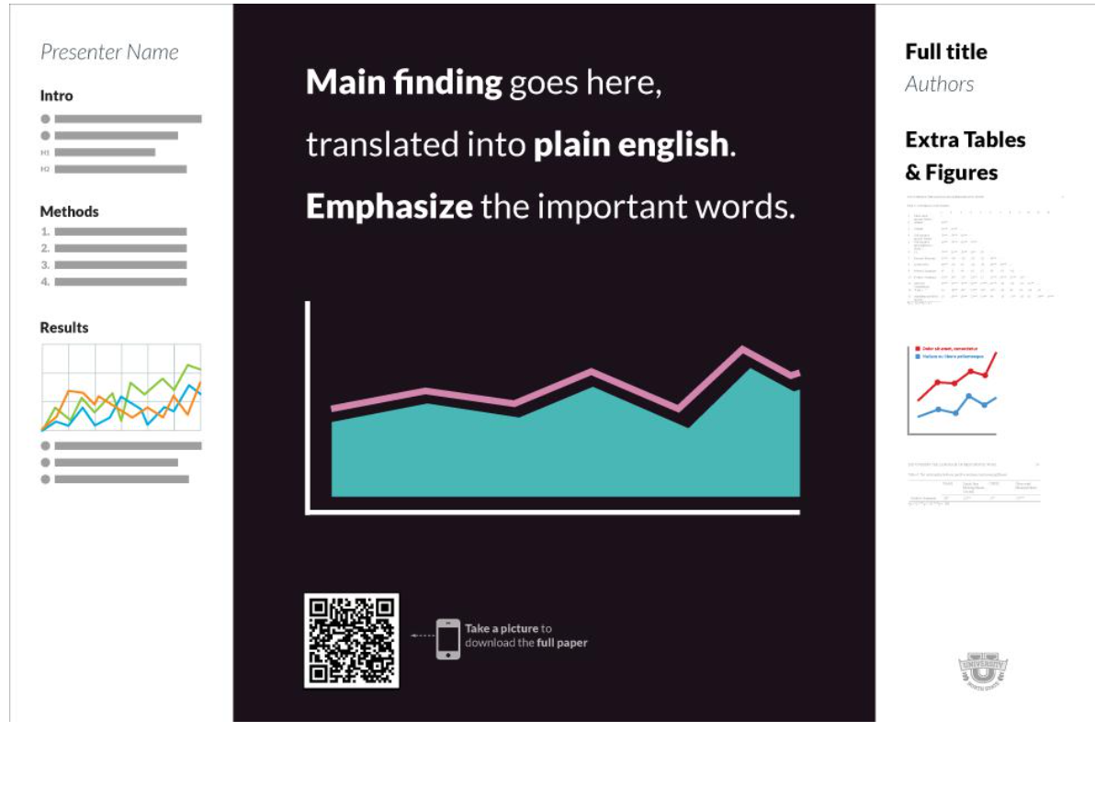
Better Scientific Poster Template

Slide 12
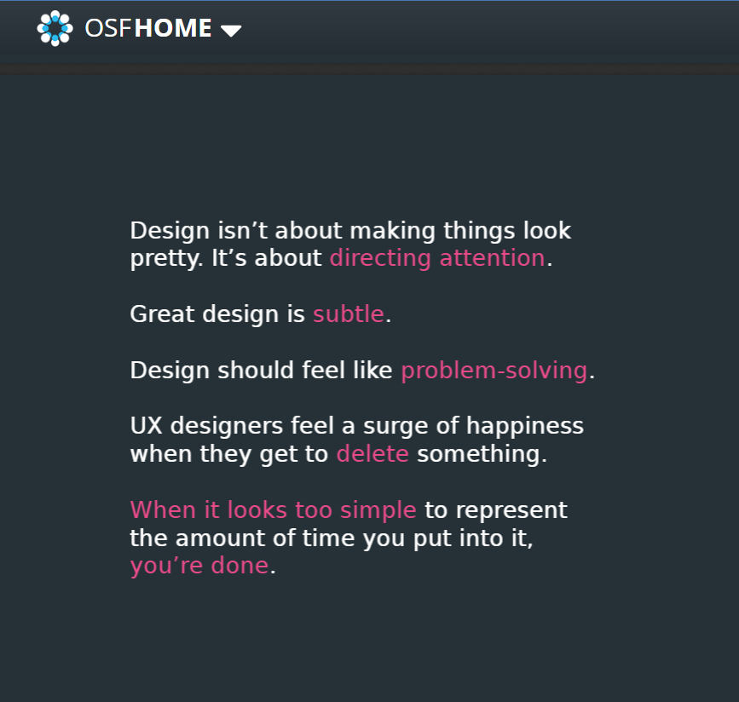
Center for Open Science
https://osf.io/6ua4k

Slide 13
Work session: Start a draft poster (template available on Canvas)

Slide 14
Break

Slide 15
Oral Presentations
Talks are usually 10-12 minutes, with a few minutes for questions
Sessions are organized by topic/category
Main Goal: Get people interested in your work
There’s no time for details; focus on big picture

Slide 16
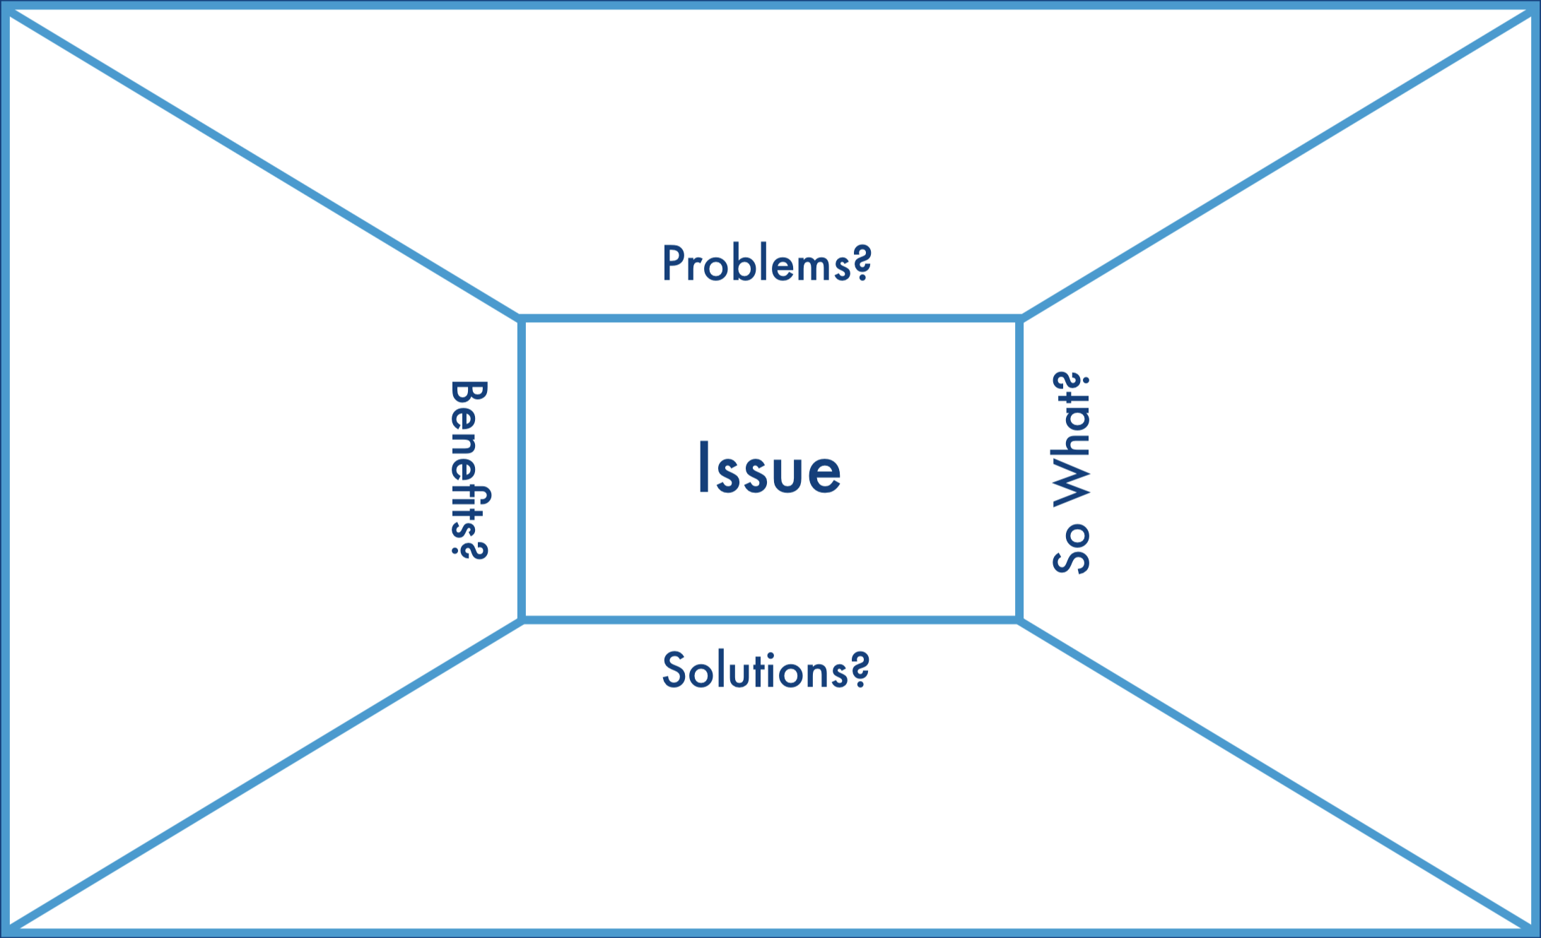
Oral Presentations
Do your audience analysis FIRST to inform your
Introduction, Methods, Results
Vocabulary
Supporting images

Slide 17
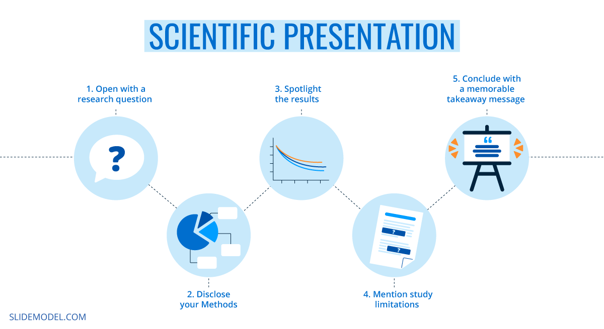
Oral Presentations
Do not start making slides immediately!
Start with an outline
Intro
Methods
Results
Discussion/Next steps
There’s no need to explicitly describe the outline in the talk

Slide 18
Oral Presentations
Introduction (2-4 slides)
Introduce yourself, affiliation, contact details
*Even if you are nervous, you can say your name confidently!
Motivation: Clearly state why this research matters
Define your aim/purpose
Provide some context (how your work relates to other research)

Slide 19
Oral Presentations
Methods (4-5 slides)
What, When, Where, How data is collected and analyzed
Results (3-4 slides)
Present key results of study
Data visualization is key; minimize words and numbers when possible

Slide 20

Oral Presentations
Finishing Slides
End your talk with powerful “Take Home” message
Include acknowledgements of committee, advisor, and funding!
Saying “I’d be happy to take questions if there are any. Thank you” is a clear signal you are finished. The audience will almost always hold applause until you say “Thank you”

Slide 21
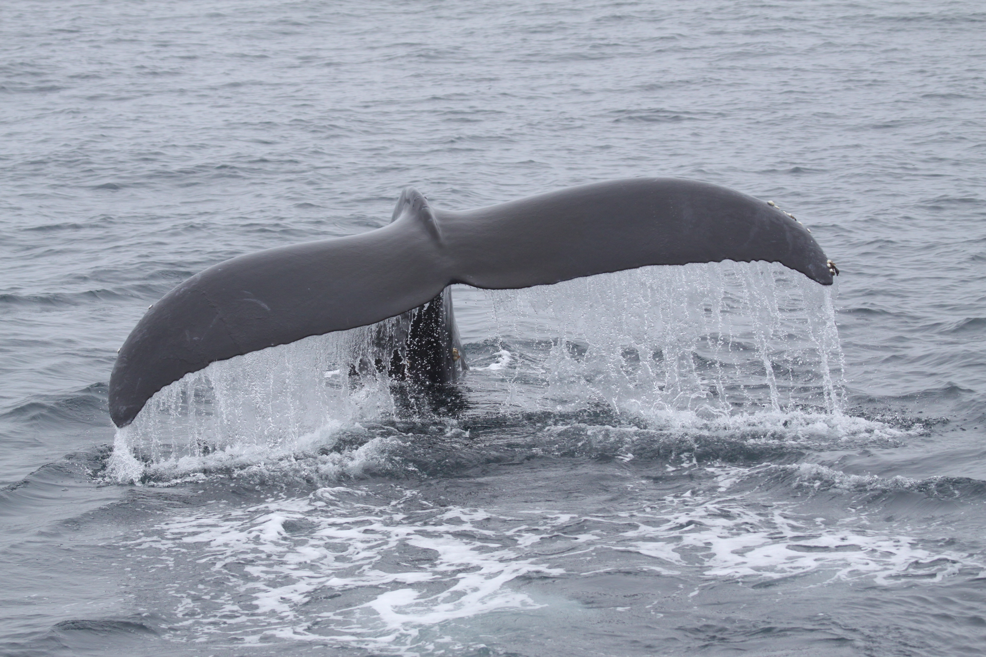
Oral Presentations
Slide Design
Use short, clear bullet points
Complete sentences are not necessary – fill in the details verbally
More images and fewer words

Slide 22
Oral Presentations
Your Delivery
Plan for about 1-2 minutes per slide
Practice, Practice Practice!!!!!
Organize practice talks with lab mates ~1 week before the presentation
Remember transition phrases, and don’t read from the script
Speak enthusiastically about your research. If you don’t care, why should they?

Slide 23

Oral Presentations
Handling Questions
Always repeat the question so everyone knows what was asked
Avoid long discussions (I’d love to talk more with you about this offline)
It’s OK if you can’t answer a question
Offer to look into it
Suggest resources that might lead to an answer
Ask for suggestions from the audience (If anyone has expertise on this, let’s follow up after the session)
Image: Kennedy Library

